Slide 1
Install Keras on Anaconda
TA

Slide 2
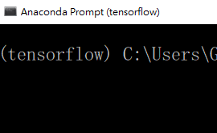
Step 1. Install tensorflow
Activate Anaconda Prompt, enter command: activate tensorflow
Check if (tensorflow) appear on your cmd.
Enter command: pip install tensorflow
Or maybe there already exist Anaconda Prompt(tensorflow) on your list, you can start with it and go to step 2.

Slide 3
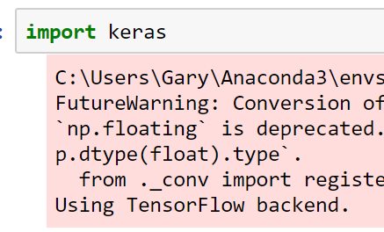
Step 2. Install Keras
Enter command: pip install keras
After finish the installation, enter jupyter notebook and open a file, enter: import keras
If it shows: Using TensorFlow backend, the installation is done

